Slide 1

WEBSCRAPER + CLI UI
By Pol irurre martínez

Slide 2
What’s a webscraper?
Extracting data from a site html file
Storing data to serve any purpose
Time-efficient way of getting data

Slide 3
Puppeteer
Pupeteer is a programatically functioning browser and it is headless. Allowing us to open multiple tabs.
Some other interesting functions are:
Generate screenshots and PDFs of pages.
Crawl a SPA (Single-Page Application) and generate pre-rendered content (i.e. "SSR" (Server-Side Rendering)).
Automate form submission, UI testing, keyboard input, etc.
Create an up-to-date, automated testing environment.
Capture a timeline-trace of your site to help diagnose performance issues.
Test Chrome Extensions.

Slide 4
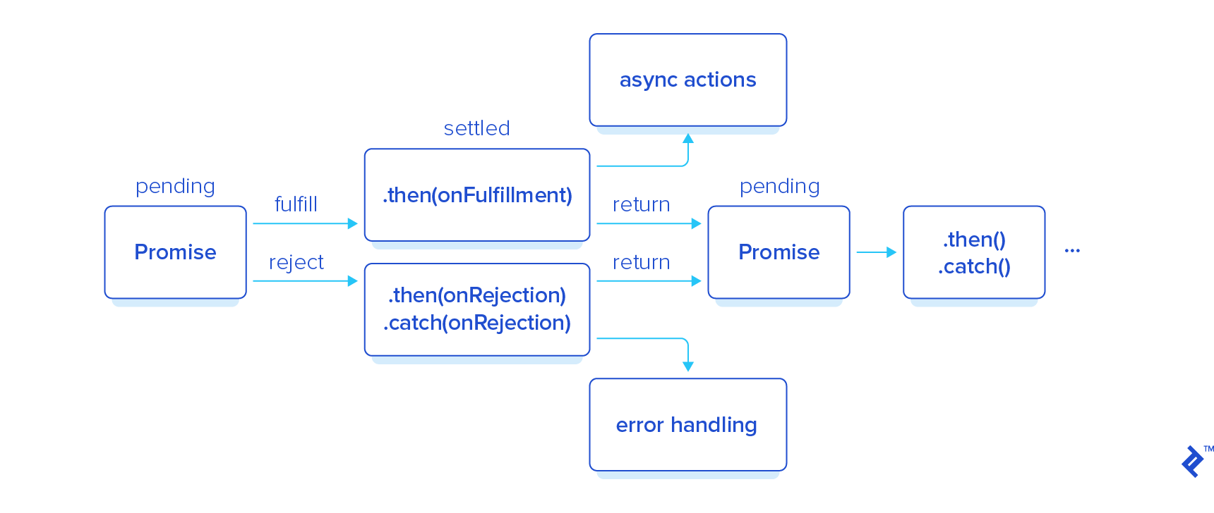
Node.js
The developing environment used is javaScript. There’s some functions node.js enables I had to learn:
Async: An async function returns a Promise, if such promise is an integer, string, etc. The promise returned will be that value. While an async function is running we can keep reading code.
Await: At some point we may need input from the async function, we use await to hold the program to get that input
Promise: Returned values from asynchronous functions
Object javascript: In javascript most objects used are
Instances of the Object class.

Slide 5
JSON
Java Script Object Notation
JSON allows to save data strings into .json files which are "easily" modified. I also used the file systems module of Node.js to write into JSON.
However to read from JSON there were many different options:
Require('data.json): This is the easiest way to obtain data from a .json file, but we aren't able to call it again so it's best suitable for .config files. The data is already a .js object
ReadFile(Sync): ReadFile methods allow to get the strings in a .json file but we will need to later parse them using the JSON.parse()

Slide 6
React
React is a javascript library which merges JavaScript+HTML+CSS, it is ideal for web apps.
I worked with webhooks, which I had never done before, to create the book search functionality.
The hook I used was the useState function, this would be translated in Java to a class that has a function constantly called to check values in case of change to update a variable.
Using hooks the code took about 10 lines, it's an efficient way to code.

Slide 7
CLI
When looking at possible React Apps I discovered INK, a library developed to give Command Line Interfaces (your plain terminal) the same tools available in React Native.
Modules in INK are a bit more difficult to integrate into code as they are installed separately from the INK native library.

Slide 8
https://books.toscrape.com/

Slide 9
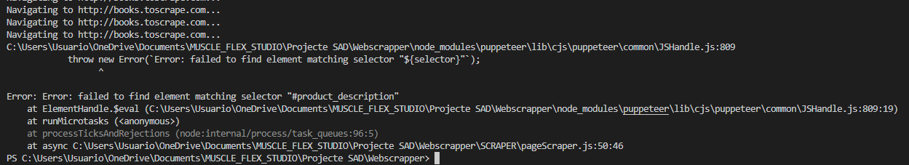
ISSUES

Slide 10
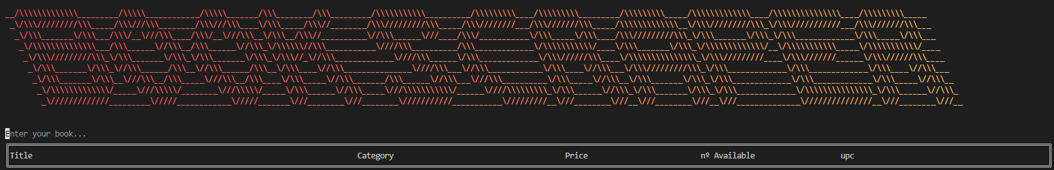
TIME TO LOOK FOR A BOOK

